Slide 1
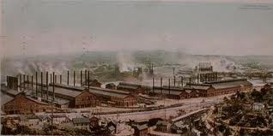
Big Business DBQ (2012)

Slide 2
Prompt
In the post-Civil War United States, corporations grew significantly in number, size, and influence. Analyze the impact of big business on the economy and politics and the responses of Americans to these changes. Confine your answer to the period 1870 to 1900.

Slide 3
Break Down the Question
Time frame ?
Type of question: Analyze ?
Categories ?

Slide 4
Impacts (Economic) | Impacts (Political) | Responses of Americans

